Slide 1
WAMIS – GePNIC (Integrated)
PHASE- I
(WAMIS)
PHASE- II
(e-Procurement)
PHASE- III
(WAMIS)
Creation of Work
Tender publication and Bidding Process
Post Tendering process
Preparation of
e-Estimate
Auto Technical Evaluation
e-Measurement Book
Administrative Approval
e- Billing
Technical Sanction
Financial Evaluation
e-Accounts
Preparation of BoQ
e- EOT
e-LOA,
e-Agreement & Work Order
Pushing Pre- tendering data
e-Deviation

Slide 2
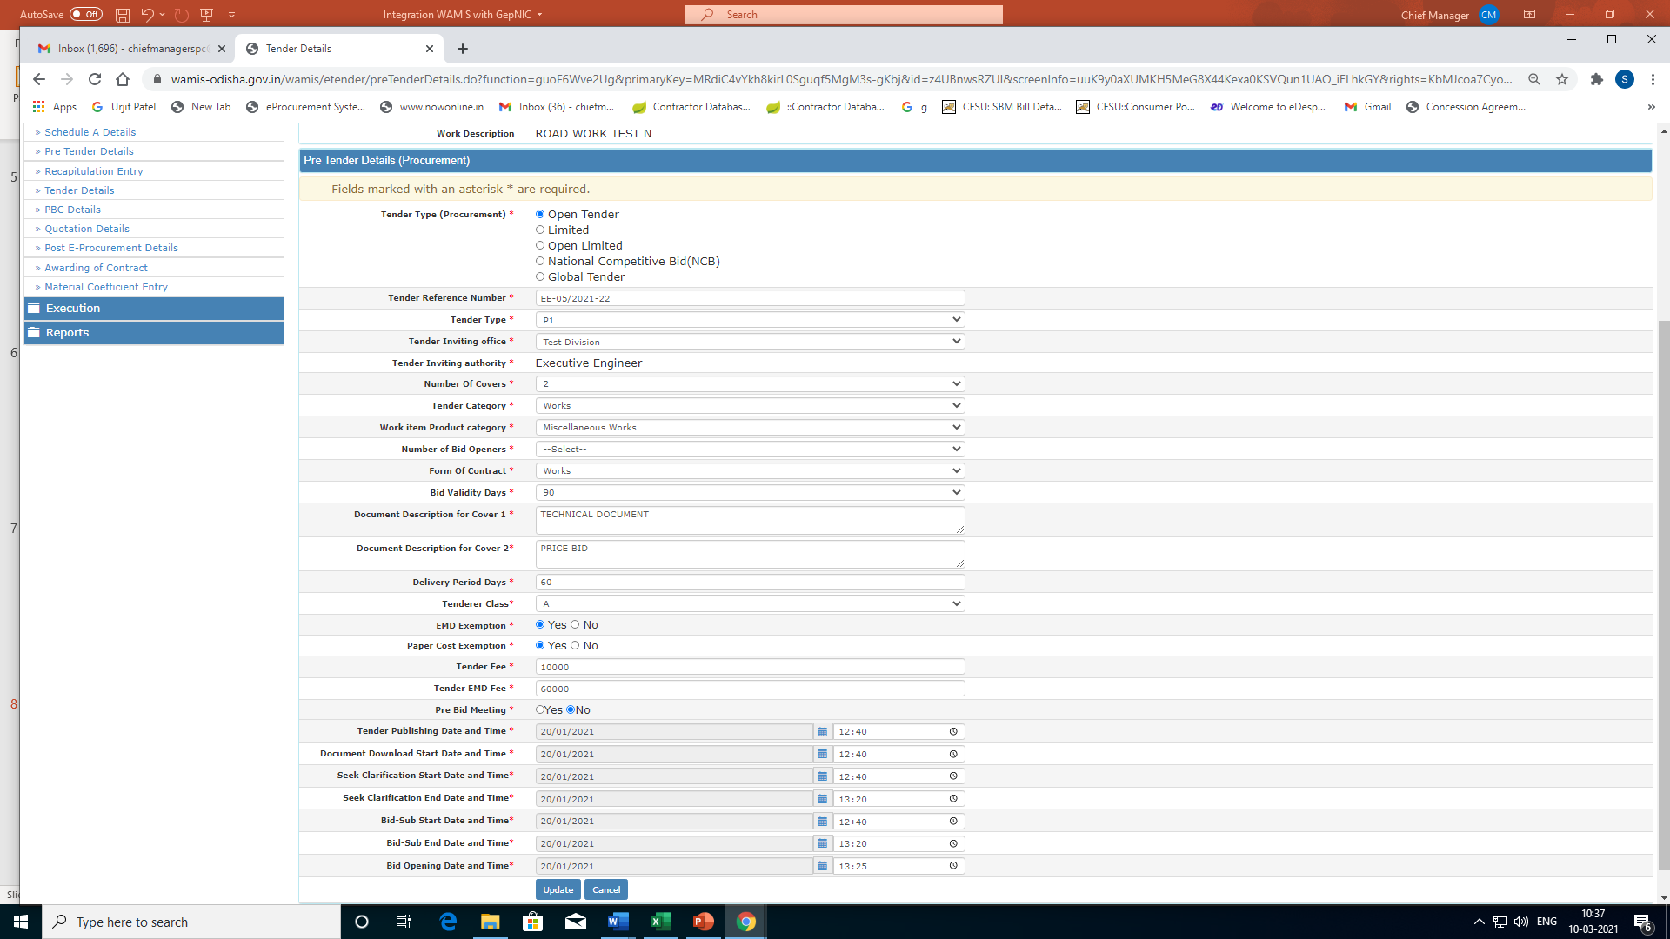
Phase-I (Pre-Tender Data)

Slide 3
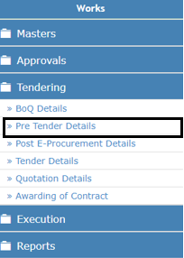
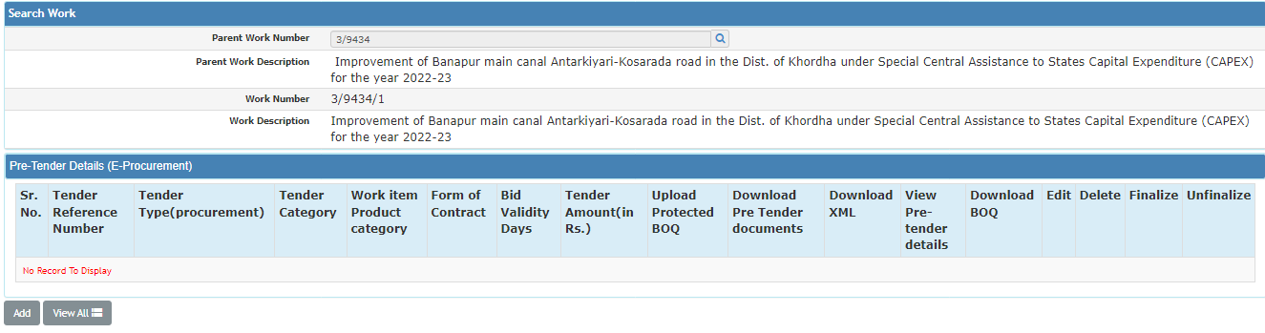
Flow of Pre-Tender Details
By selecting Works->Tendering ->Pre Tender Details, displays ‘Pre Tender Details’ screen. The Pre-Tender details required for GEPNIC portal can be prepared and submitted through the services. The below flow chart demonstrates the tender process flow as per the delegation of power.
DIVISION OFFICE
CONTROLLING OFFICE
CONTROLLING OFFICE
CIRCLE OFFICE
DIVISIONAL OFFICER
CIRCLE OFFICER
CHIEF ENGINEER
ENGINEER-IN-CHIEF

Slide 4
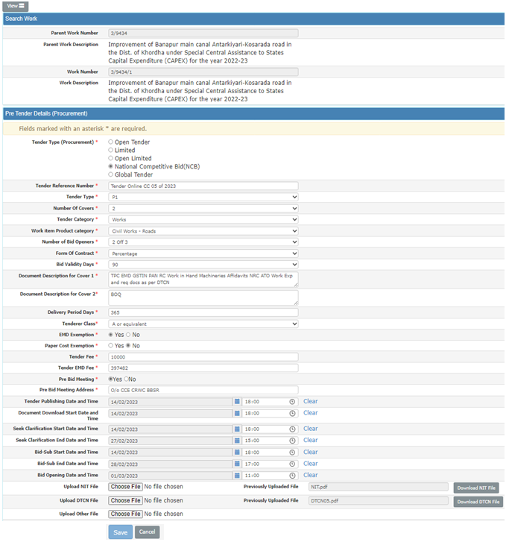
Pre-Tender entry screen

Slide 5
Enter tender reference number.
Select Tender Type, Number of covers, Tender Category, work item product category, Number of Bid Openers, Form of Contract, Tender Class etc. like mandatory fields.
Select Tender Publishing Date, Bid Opening Date etc.
Click on Save button to save pretender details.
NIT, DTCN and other required documents in the provided fields are to be uploaded by Tender Inviting Authority(TIA).

Slide 6
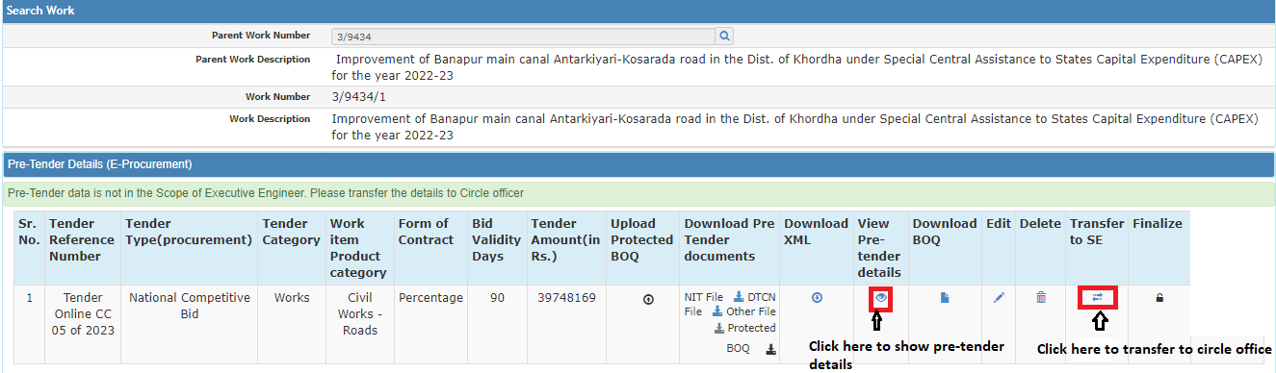
Then user will redirect to Pretender Detail List.
Divisional officer can download the NIT, DTCN & Other files if uploaded.
User also can edit pre tender details and also can delete by clicking on edit and delete button.
Pre tender details can be can be forwarded to next higher authority who is competent to invite the tender by clicking on ‘Transfer to SE’ button.
Click on Finalize icon to finalize data.
Divisional officer needs to transfer to higher authority like circle officer login in case of Tender Inviting authority is Circle Officer by clicking on ‘Transfer to SE’ button.
After clicking on ‘Transfer to SE’ button, the pre-tender details get pushed to Circle office as Circle office is the TIA for this particular work

Slide 7
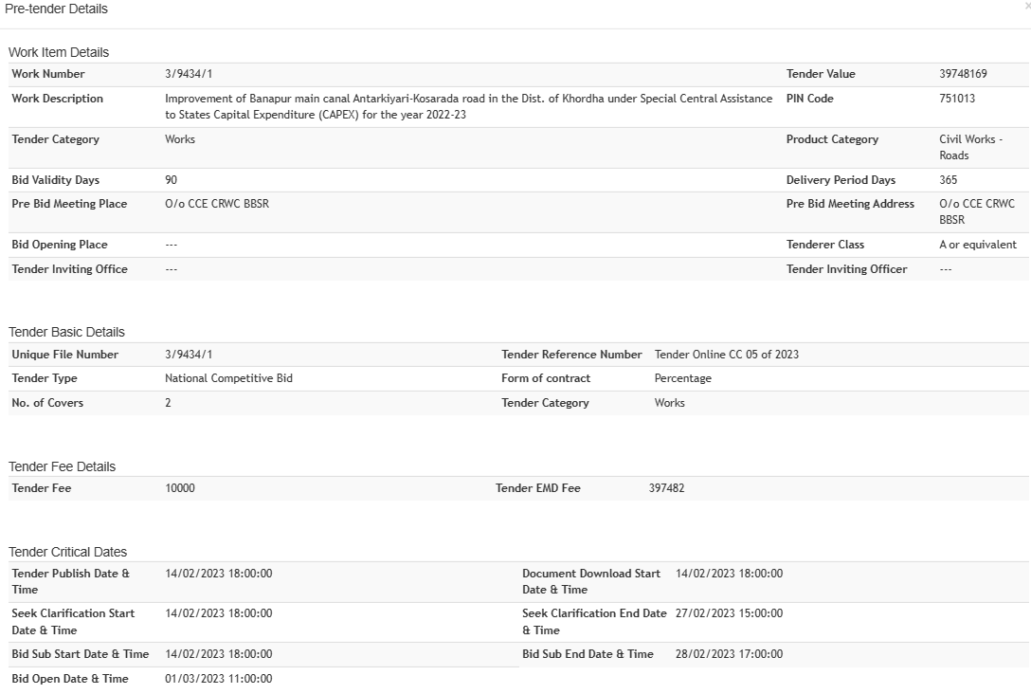
View Pre-Tender details
This screen shows the data of Pre-tender entered when user clicks on View Pre-Tender details.

Slide 8
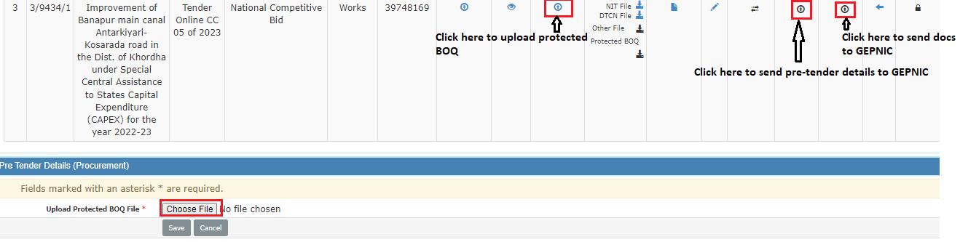
Circle Officer login
Pre-tender details to be verified and can be edited as per requirement.
On click of Upload Protected BOQ button, the Protected BOQ file to be attached and by clicking the save button the file will get uploaded.
Send back provision is also present the pre-tender details can be send back to its subordinate office.
Pre Tender detail can be push to GEPNIC by clicking on the “Send pre-tender data to GEPNIC” button.
The docs like NIT,DTCN ,BOQ can be pushed to GEPNIC by clicking on the “Upload files to GEPNIC” button.
Transfer button may be clicked if TIA is next higher authority and the same process is to be followed.

Slide 9
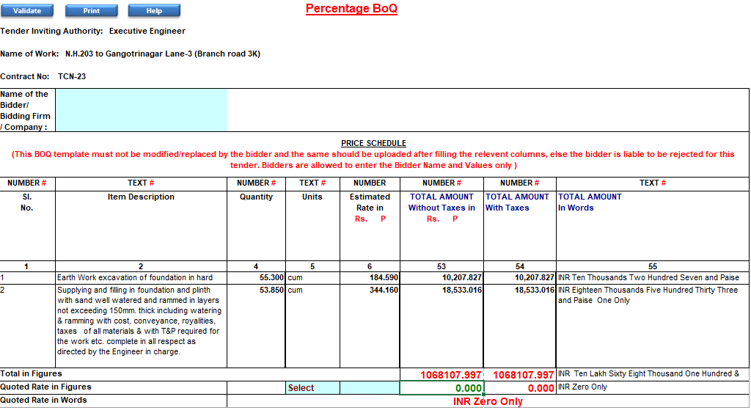
BOQ for GePNIC
The BOQ format for GEPNIC is downloaded from WAMIS and can be uploaded in GEPNIC during tender preparation.

Slide 10
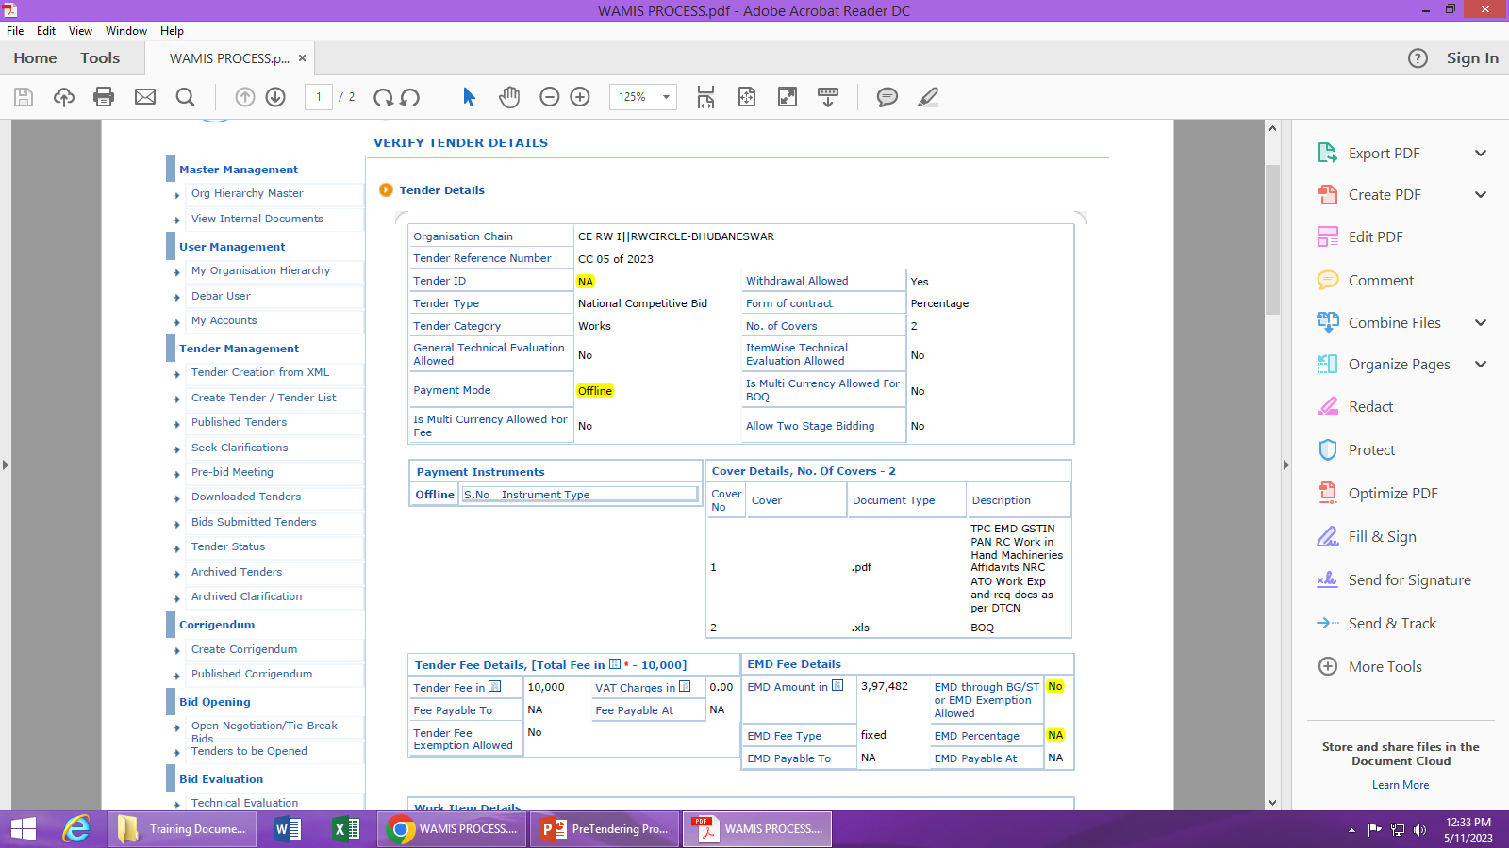
Phase-II (GePNIC)-(pretender data from WAMIS)
Click here & then click on Action against Work ID

Slide 11
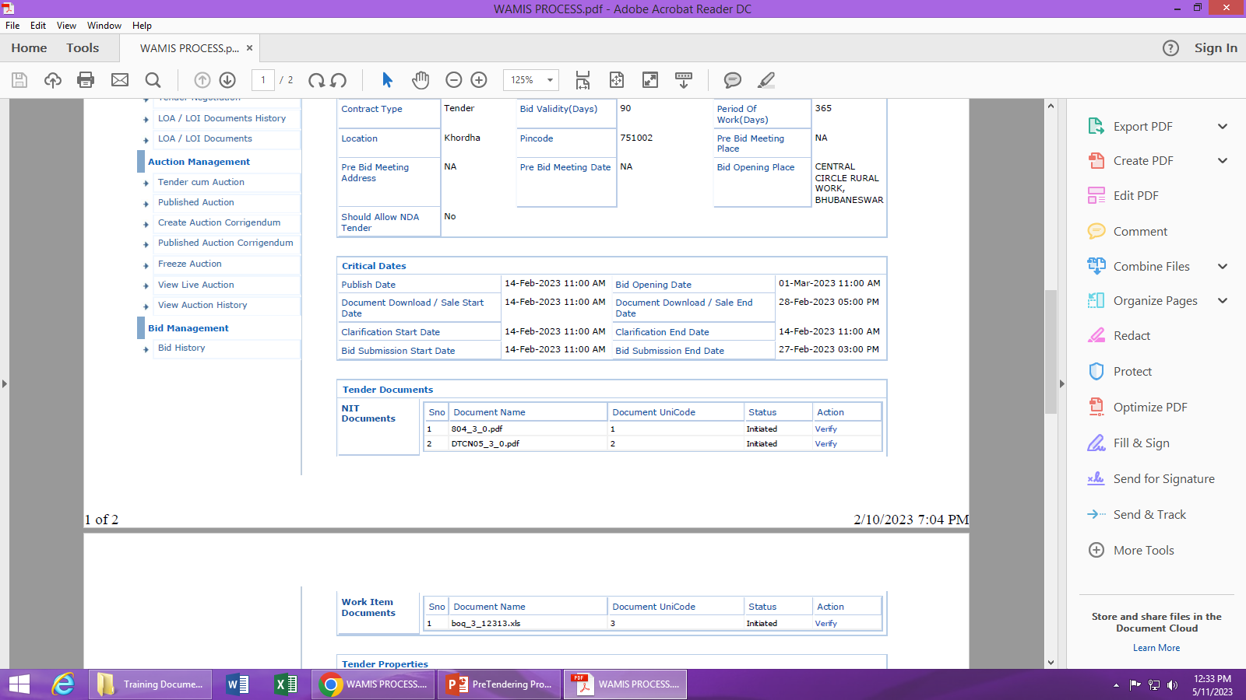
Phase-II (GePNIC)-(pretender data from WAMIS)
Click on verify to verify Tender Docs and BOQ. Then Click on Proceed

Slide 12
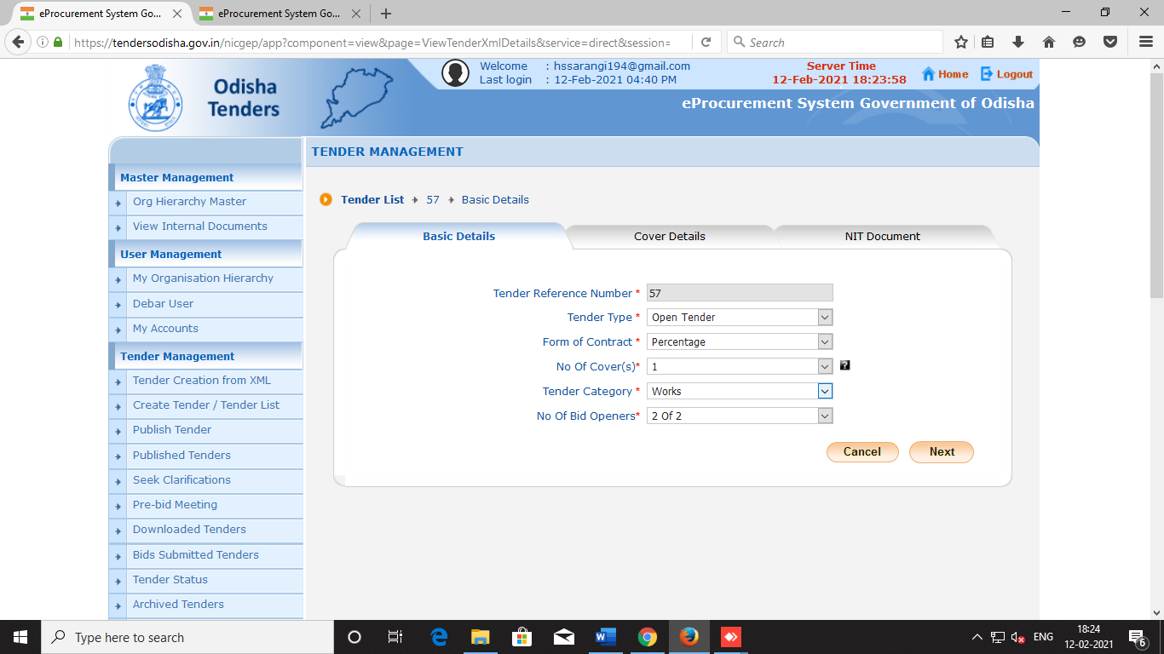
Phase-II (GePNIC)-(pretender data from WAMIS)

Slide 13
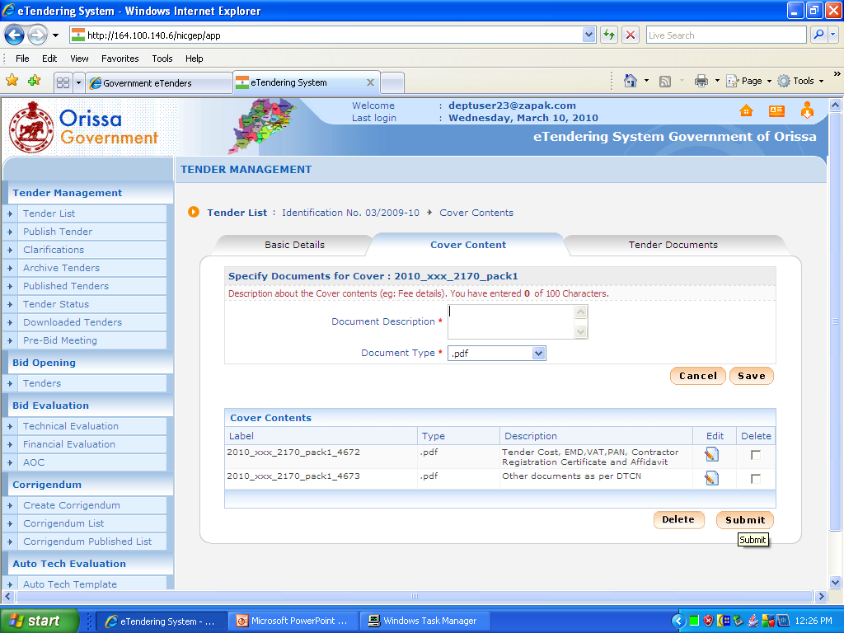
Click
Click

Slide 14
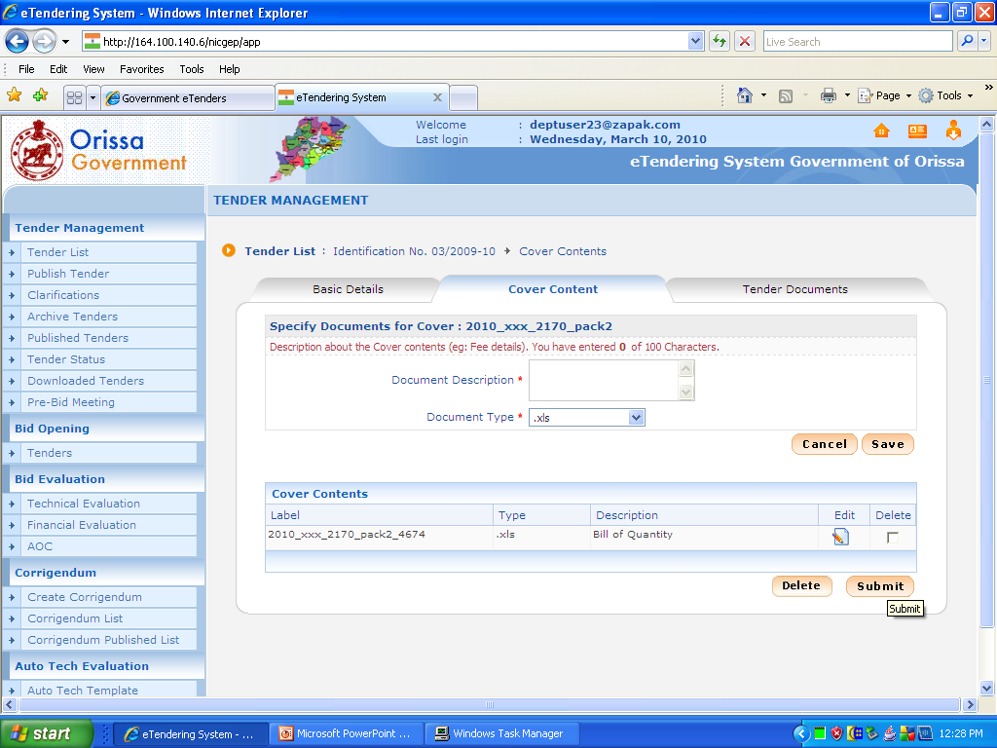
Click

Slide 15
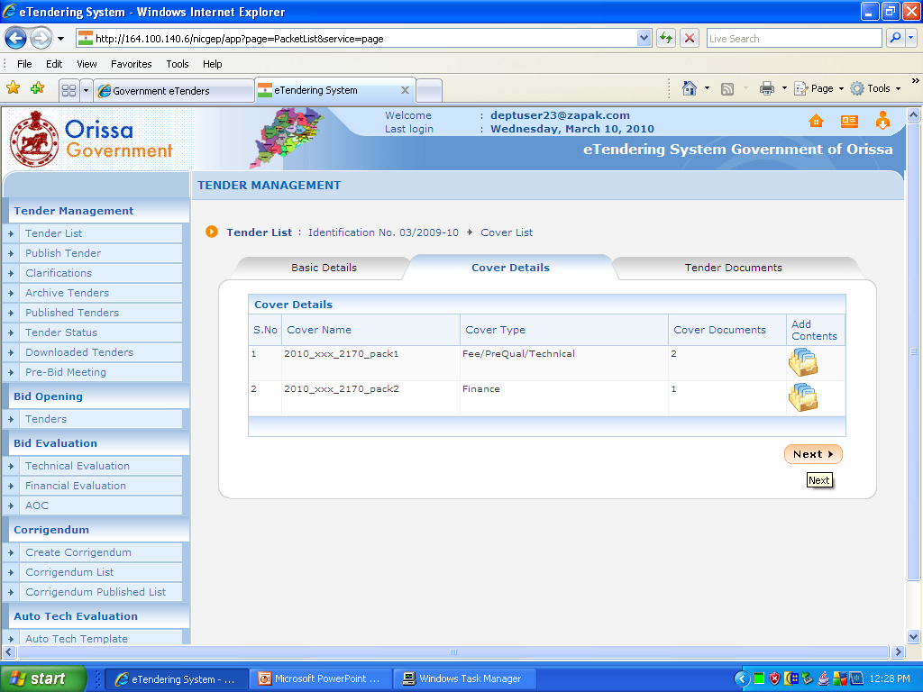
Click

Slide 16
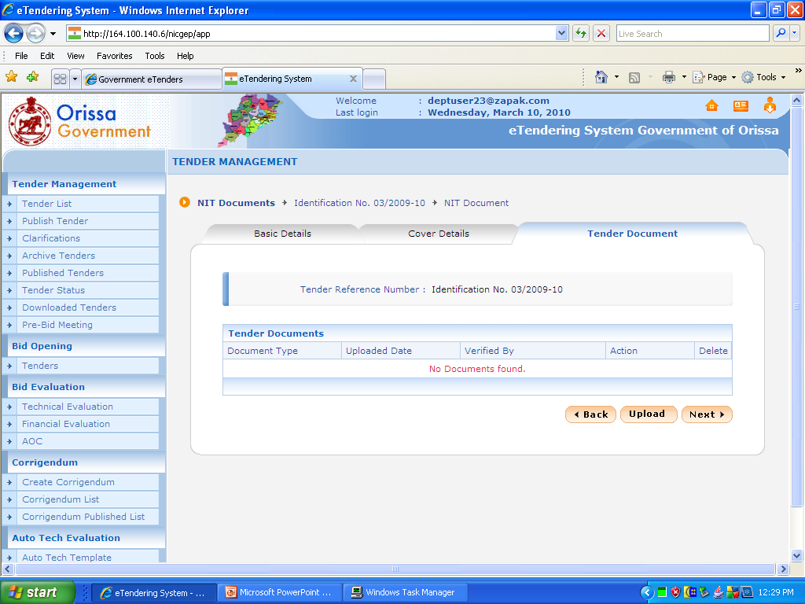
Click on ‘Upload’
Click

Slide 17
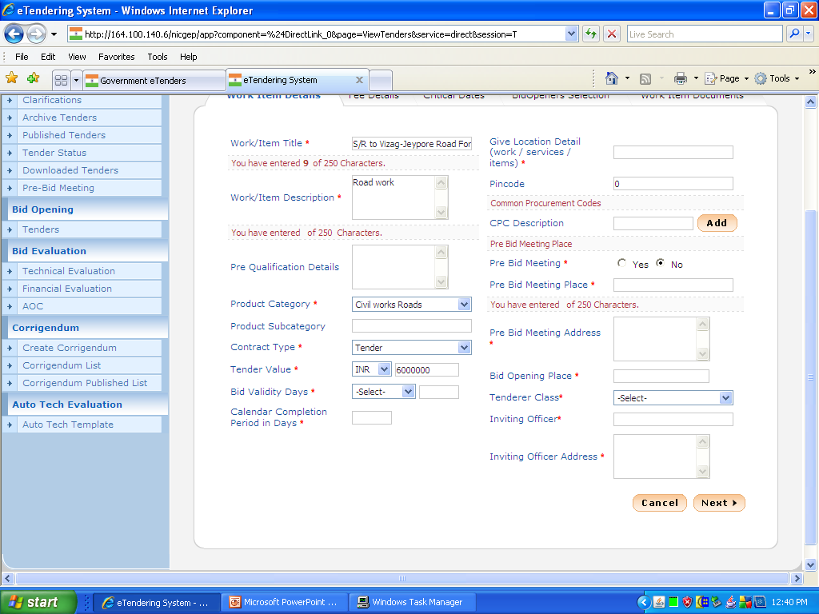

Slide 18
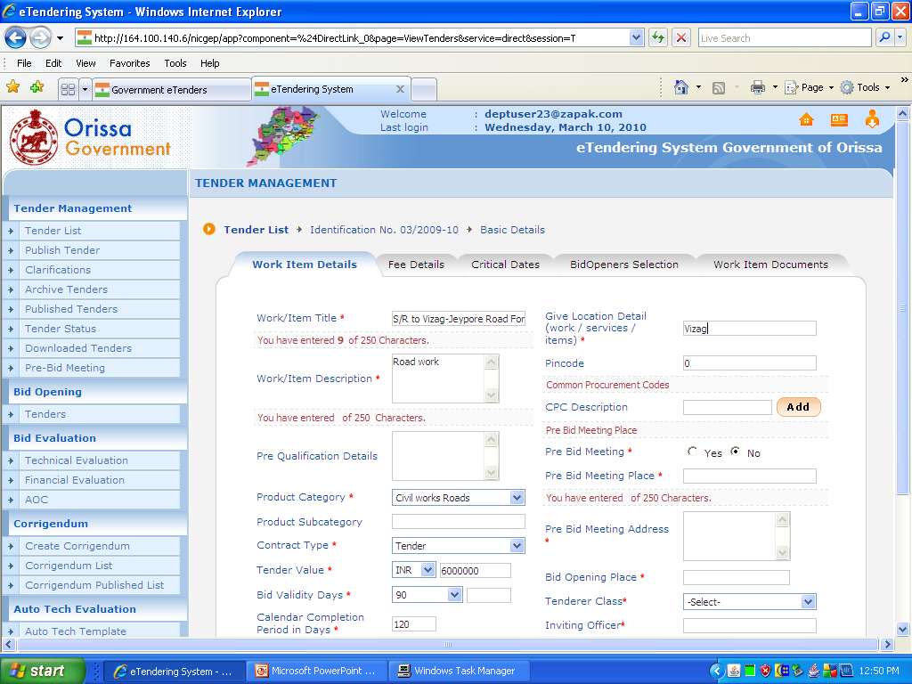

Slide 19
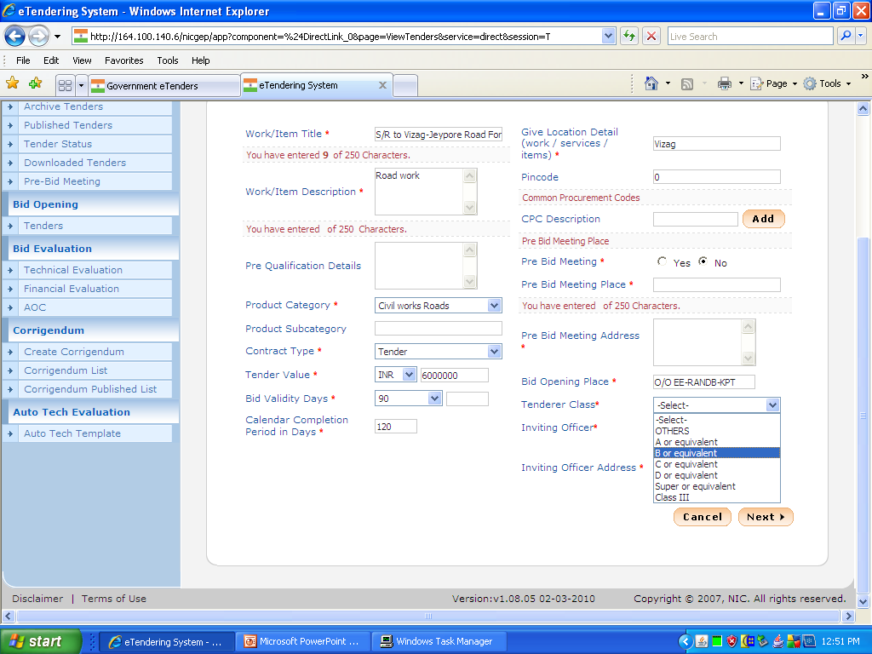

Slide 20
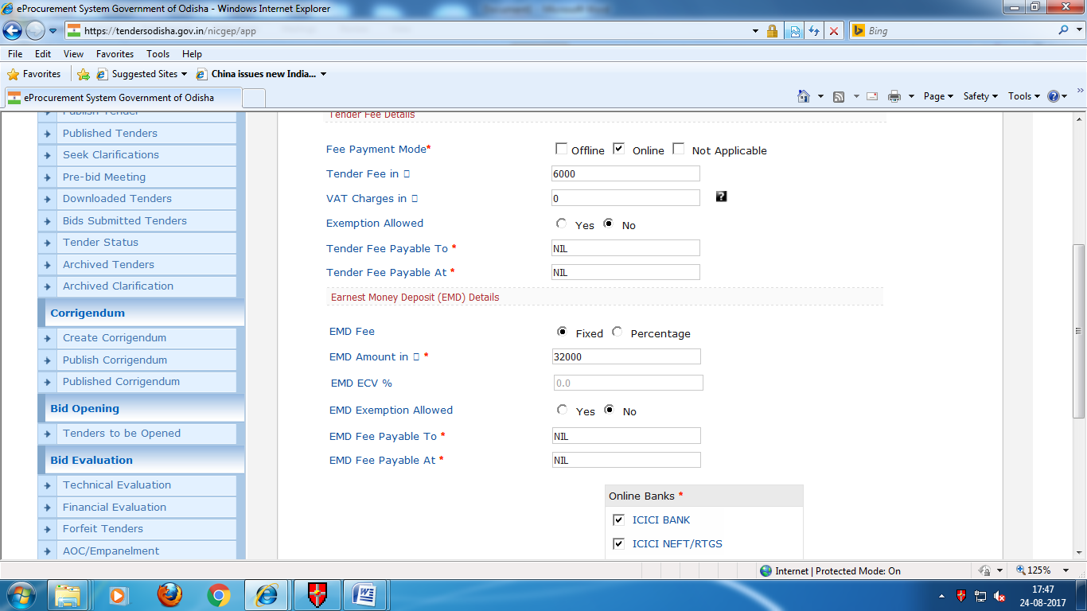

Slide 21
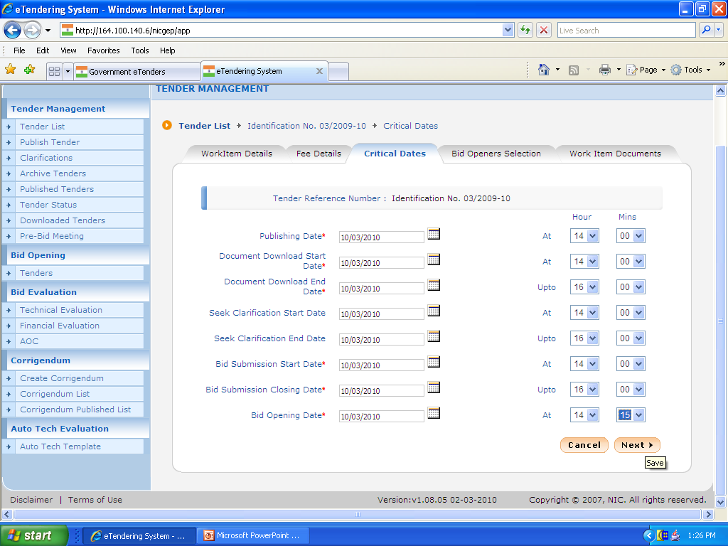
Click

Slide 22
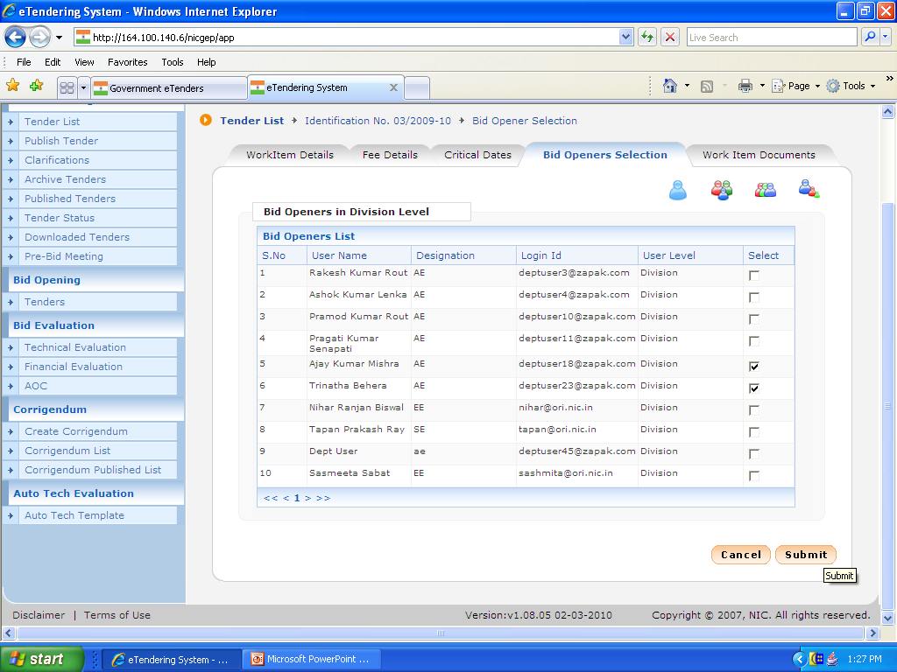
Click

Slide 23
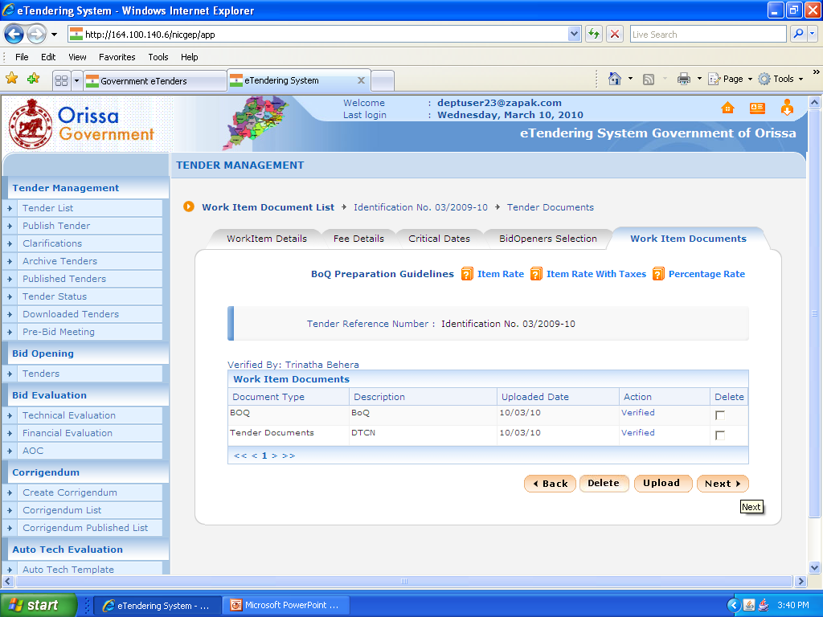
Click

Slide 24
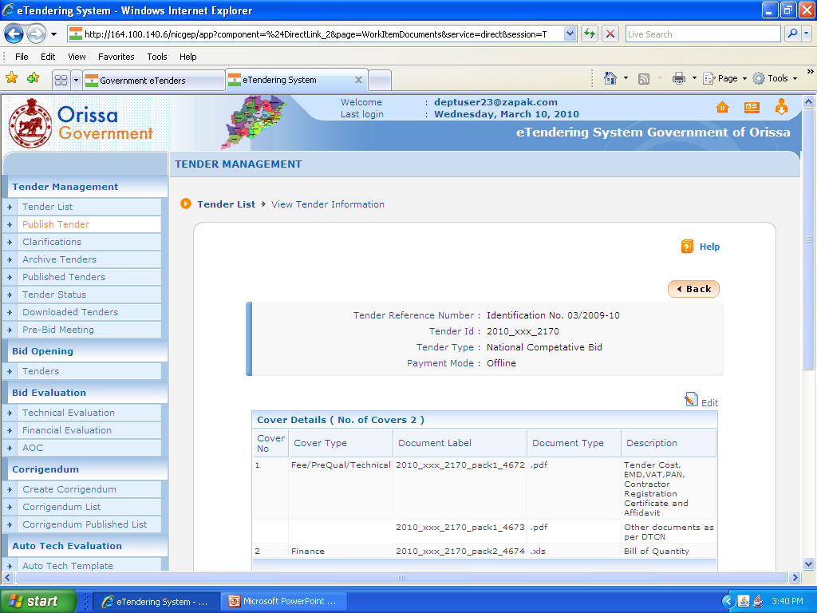

Slide 25
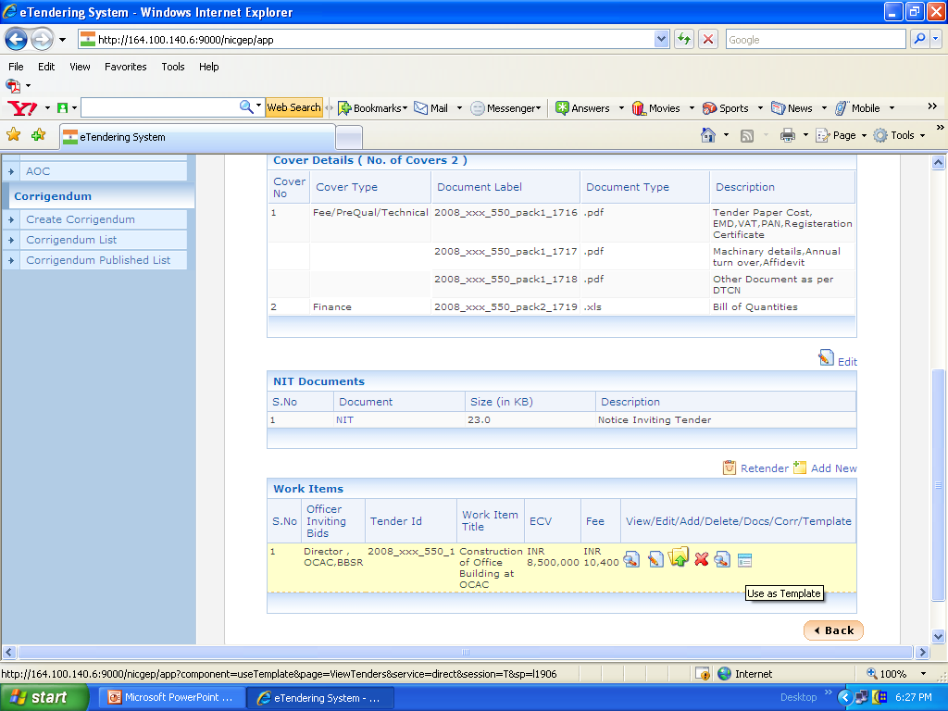
Click If you have more than one work on the same NIT then go on click Tamplet. It will automatically copy the previous details where you have to only modify some field in the Work item Details & Fee Details and the required DTCN & BoQ has to Upload and Verify.
Click

Slide 26
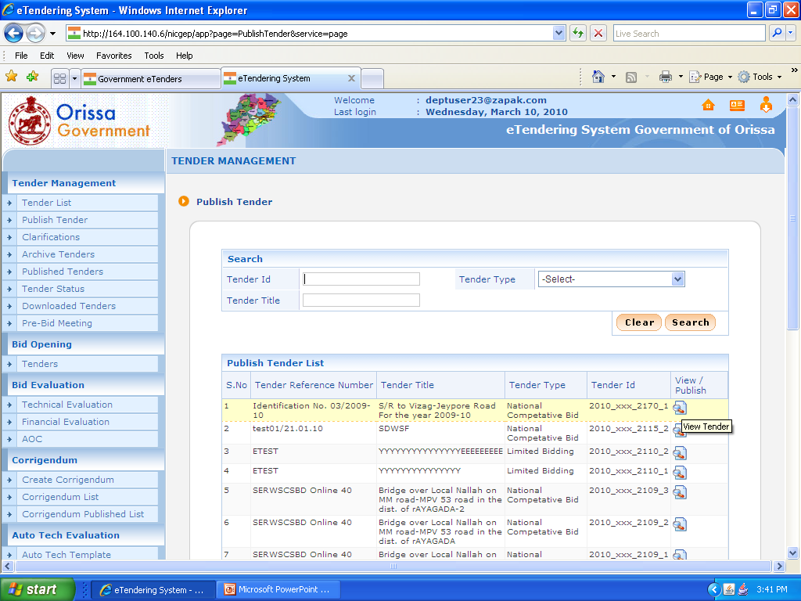
Click Now your required tender is ready for Publish. It can be done by the Higher authority’s DSC. Click on “Publish Tender”
Click

Slide 27
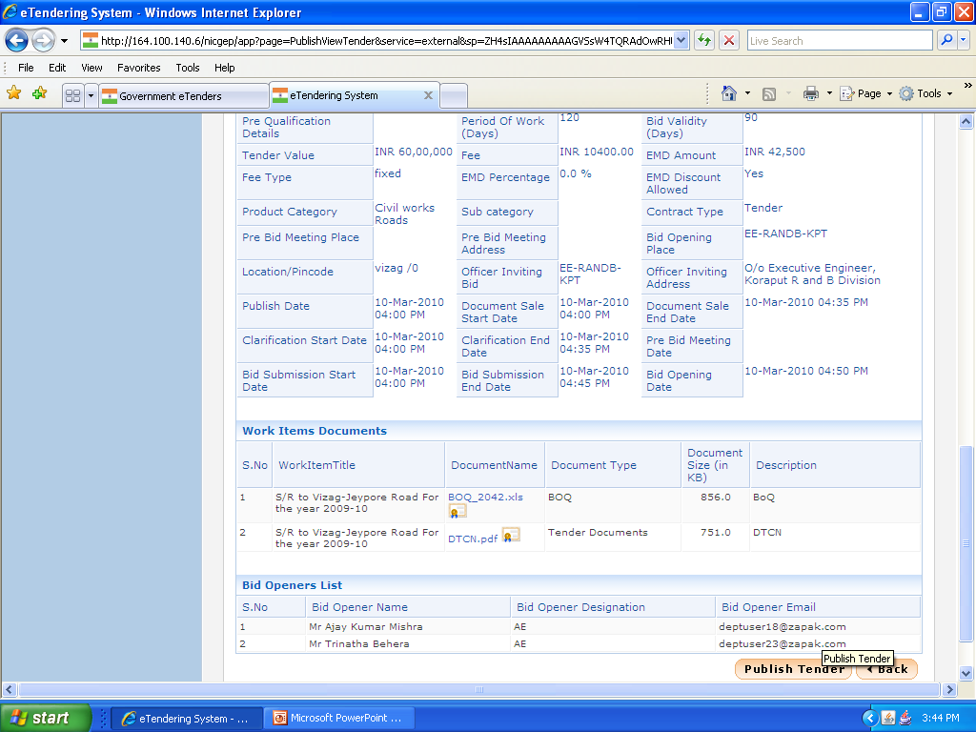
Click

Slide 28
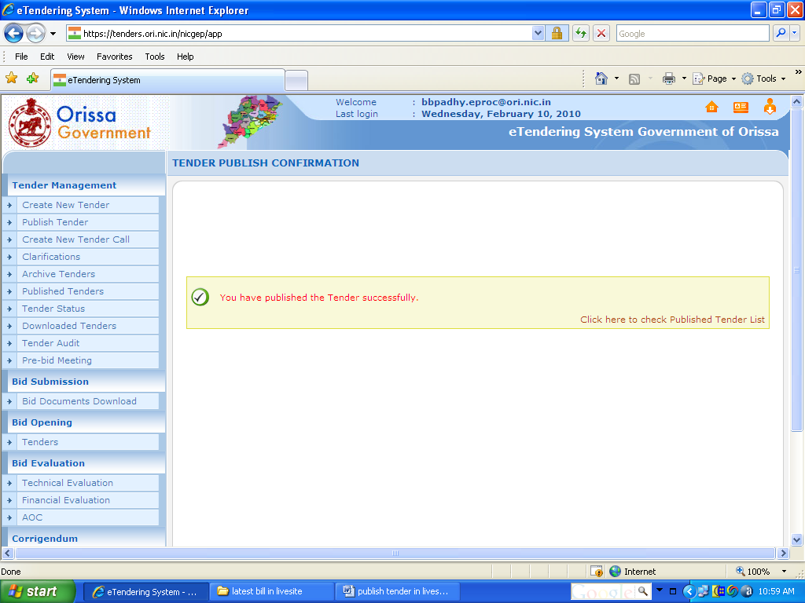

Slide 29
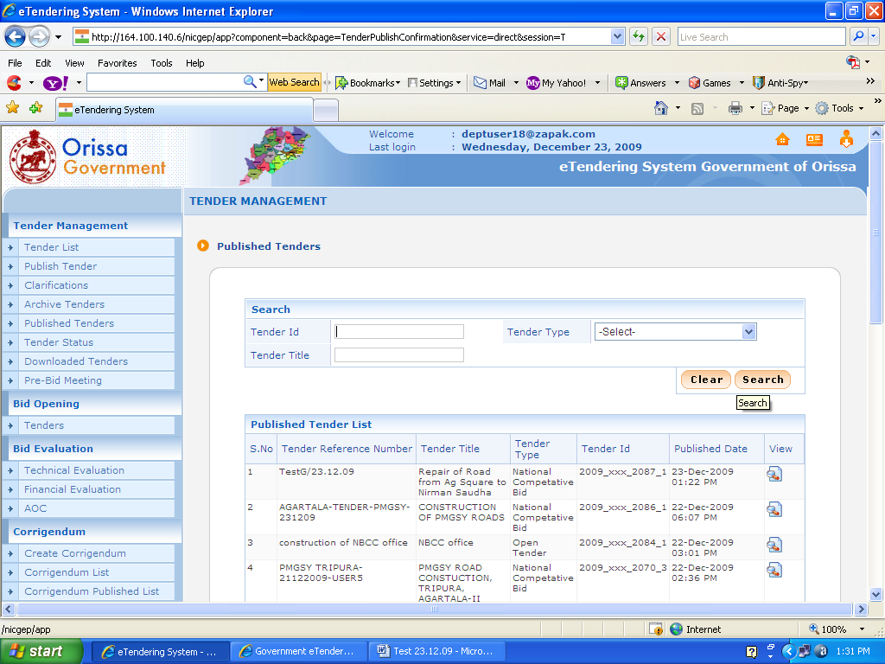
The same can be viewed in “Published Tender”

Slide 30
Opening of Tender

Slide 31
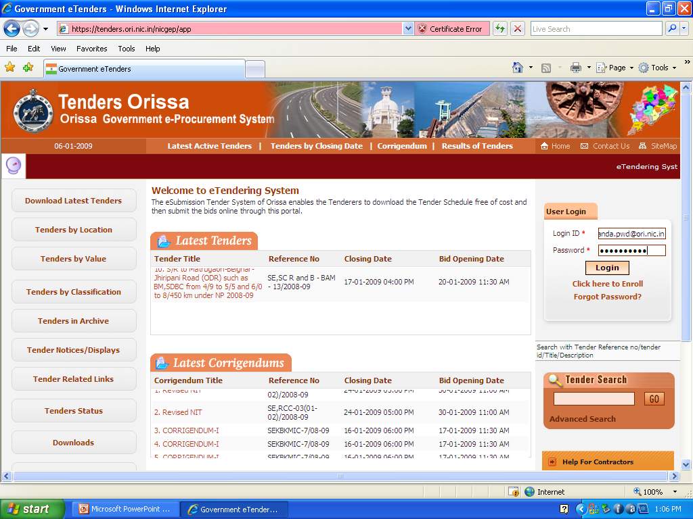
First Opener has to Login

Slide 32
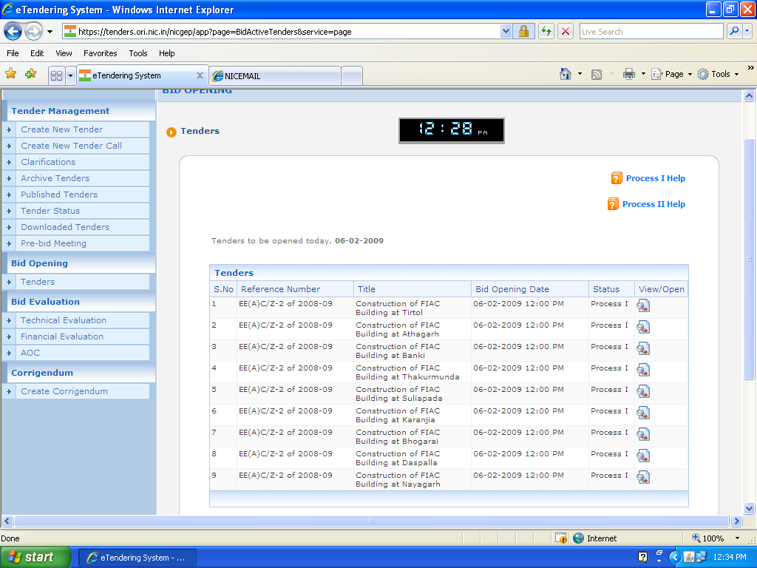
Click

Slide 33
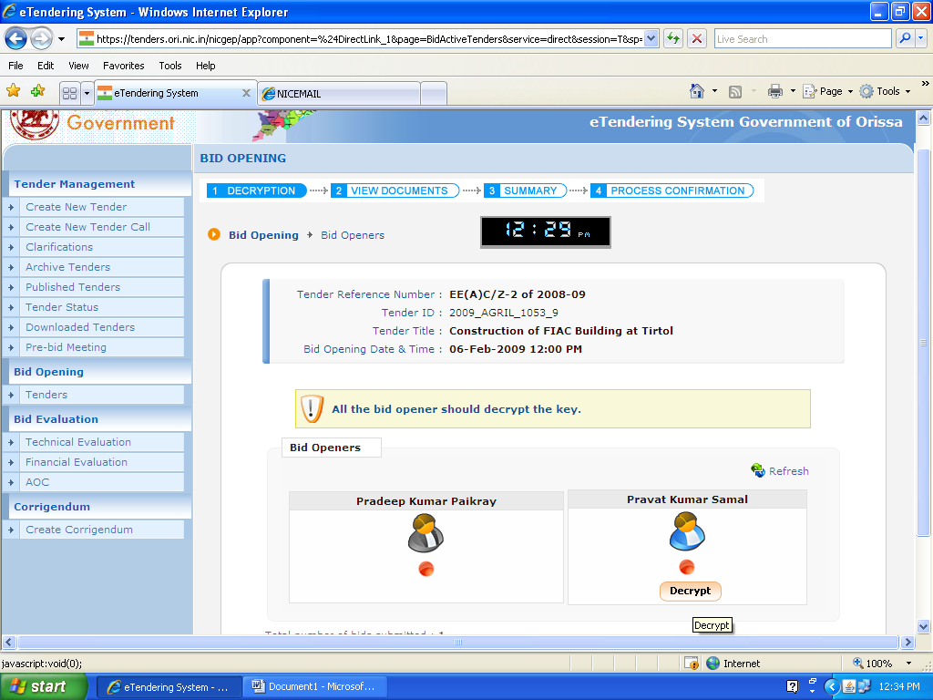
Click

Slide 34
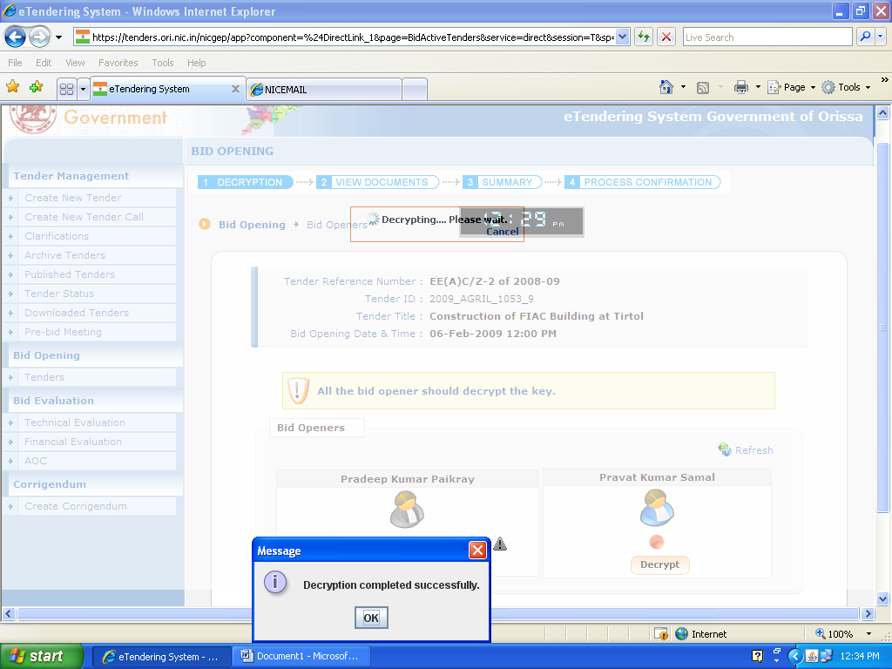
Click

Slide 35
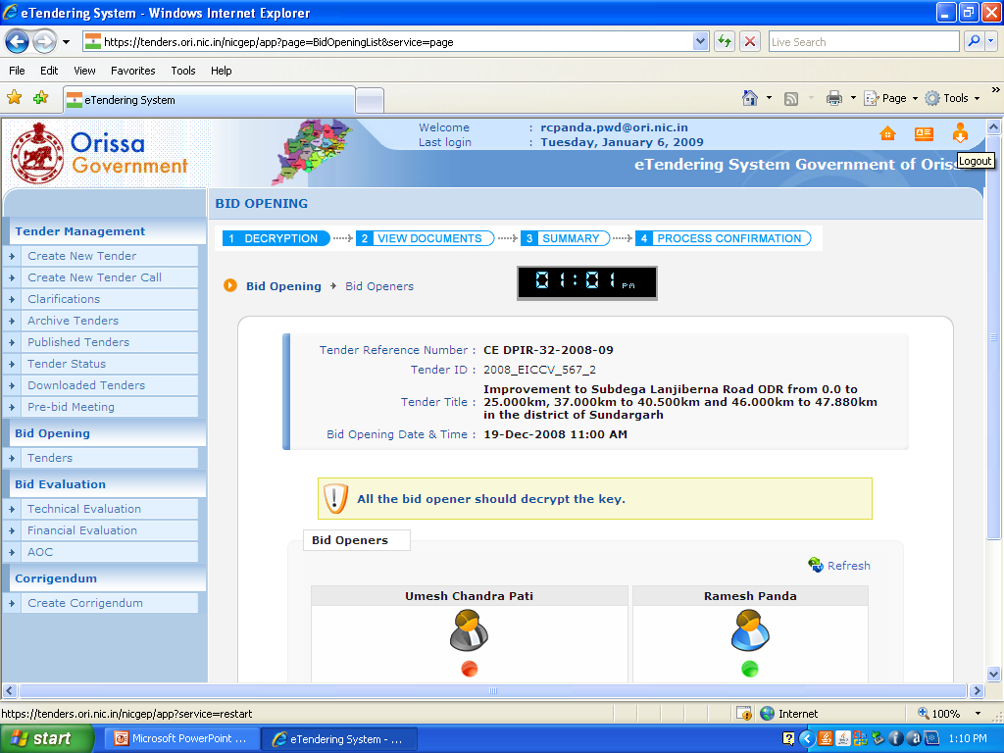
Click on Log Out

Slide 36
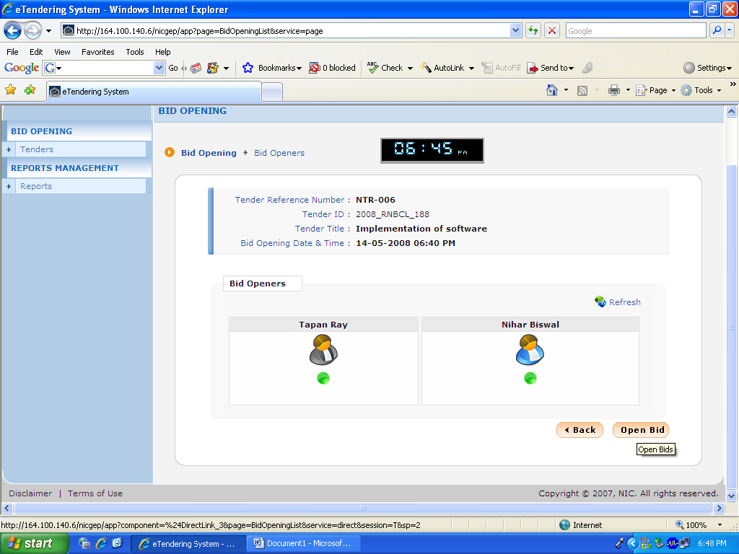
Click
Both the Openers decrypted the keys
Notes:
36

Slide 37
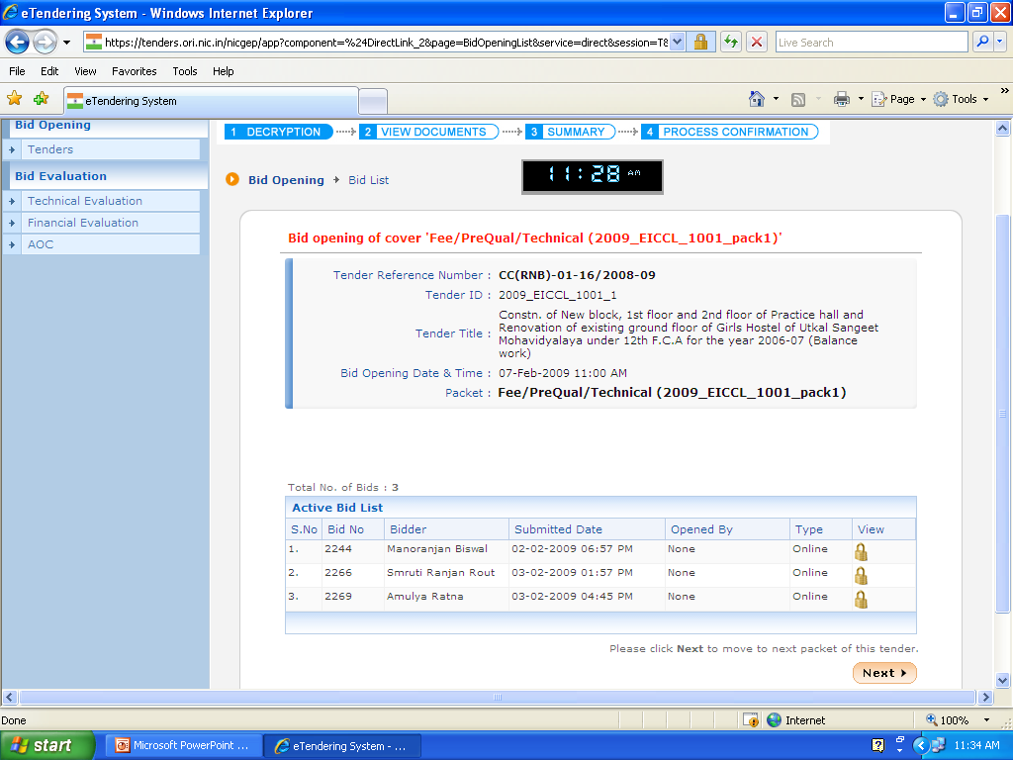
Click

Slide 38
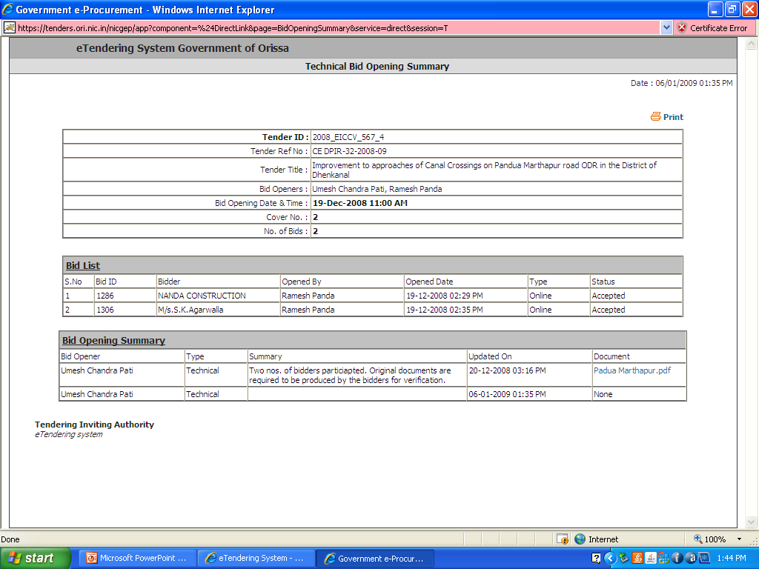

Slide 39
Evaluation

Slide 40
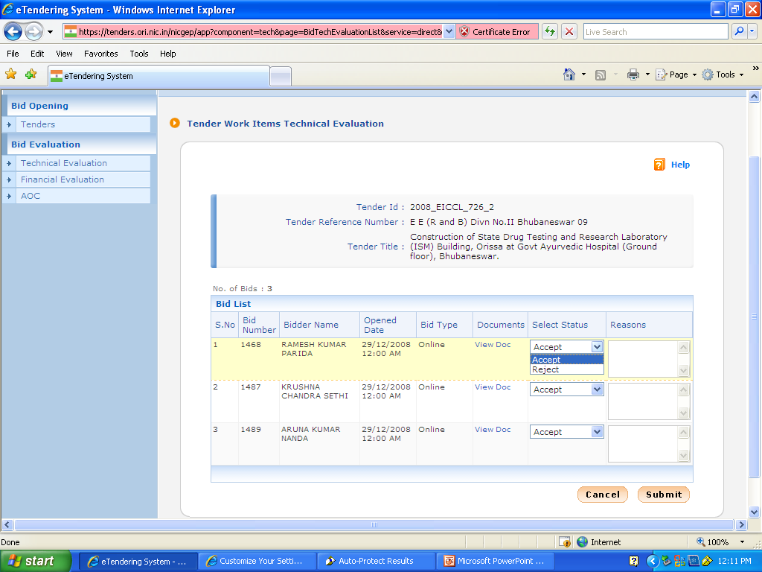

Slide 41
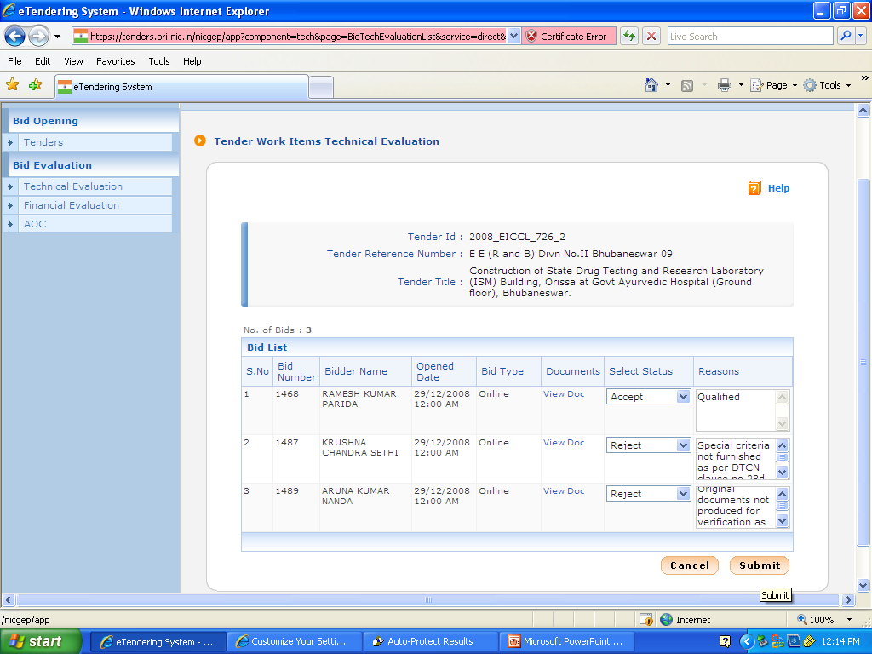

Slide 42
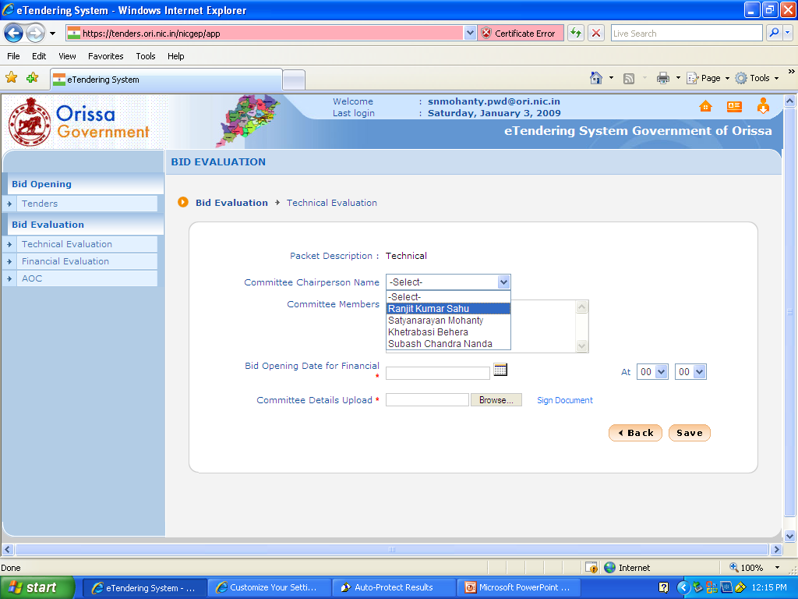

Slide 43
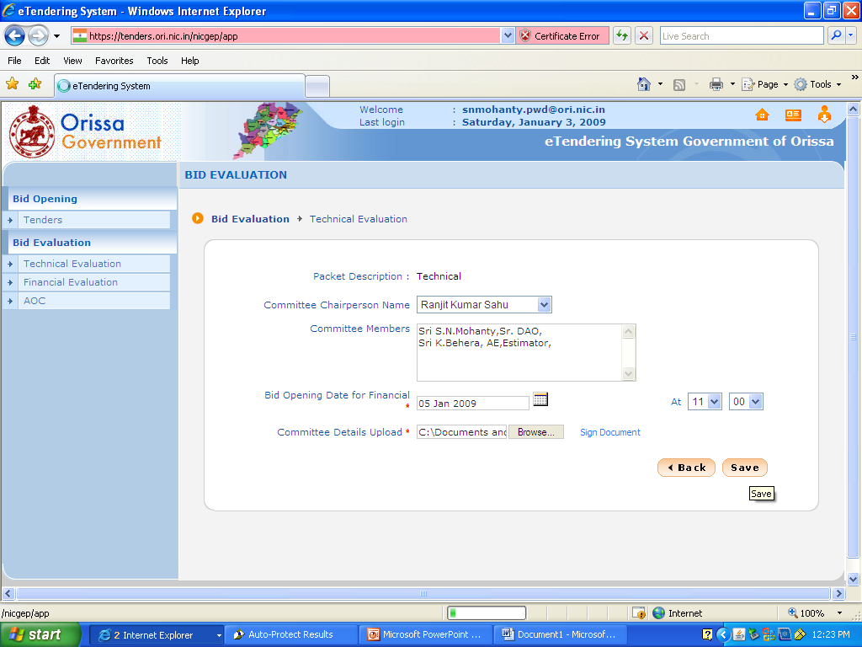

Slide 44
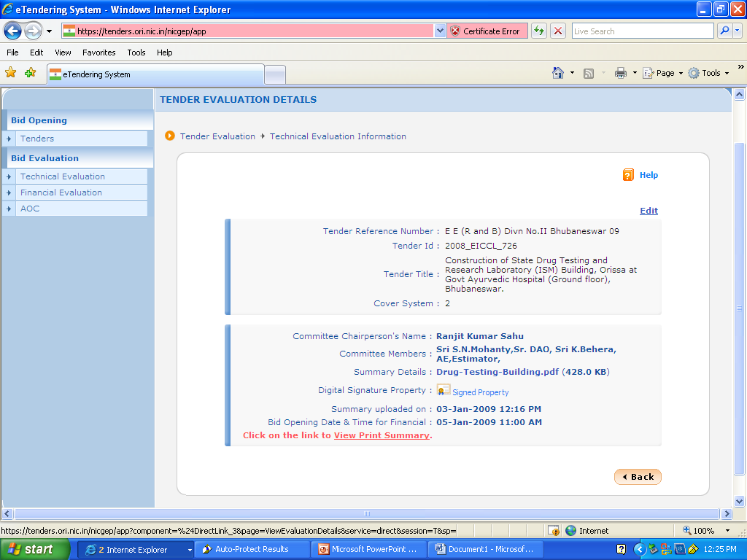

Slide 45
Award of Contract

Slide 46
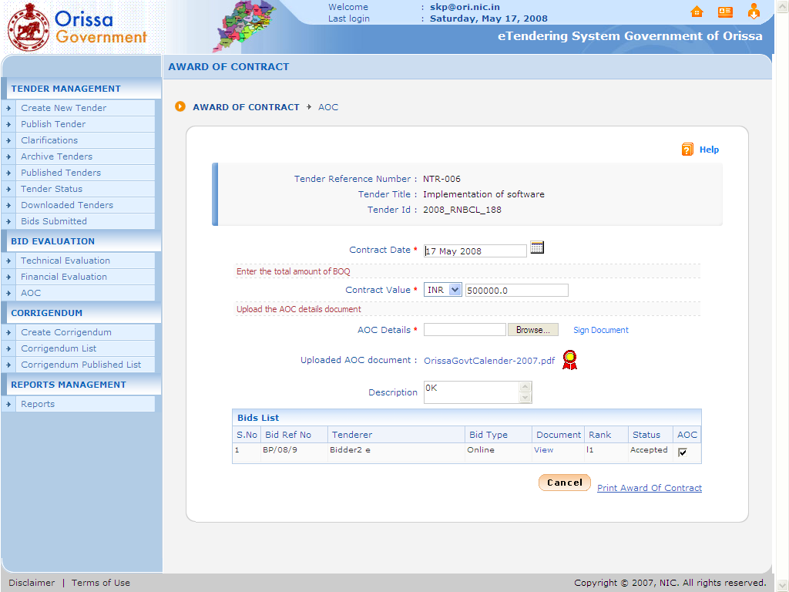
AOC ready to print

Slide 47
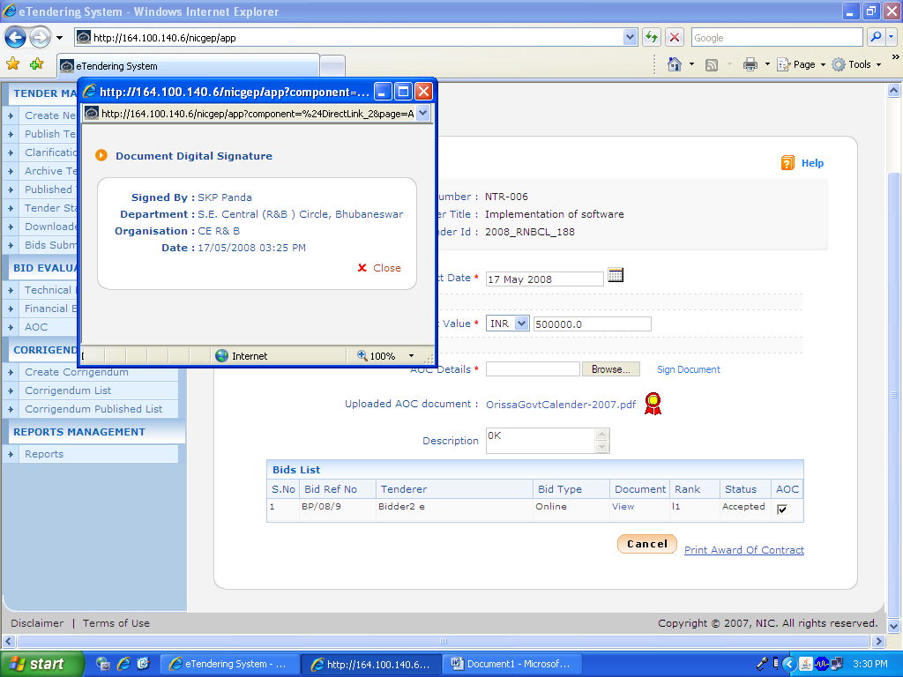

Slide 48
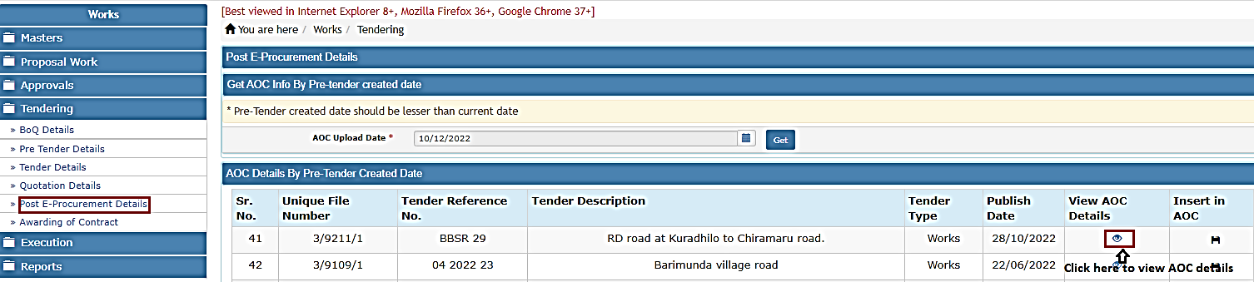
Post-tender data
By selecting Works->Tendering ->Post E-Procurement Details, displays ‘Post E-Procurement Details’ screen. After e-procurement shares the agreement details same will be consumed by WAMIS and the AOC details will show in agreement details.
User needs to Get AOC data from GEPNIC by selecting the date.
By clicking on View AOC Details user can view AOC detail

Slide 49
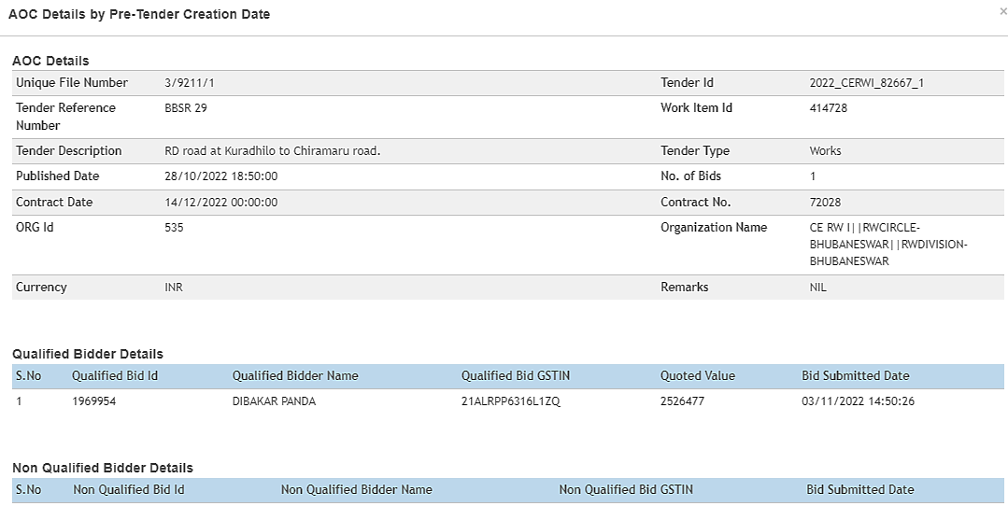
Post-tender details

Slide 50
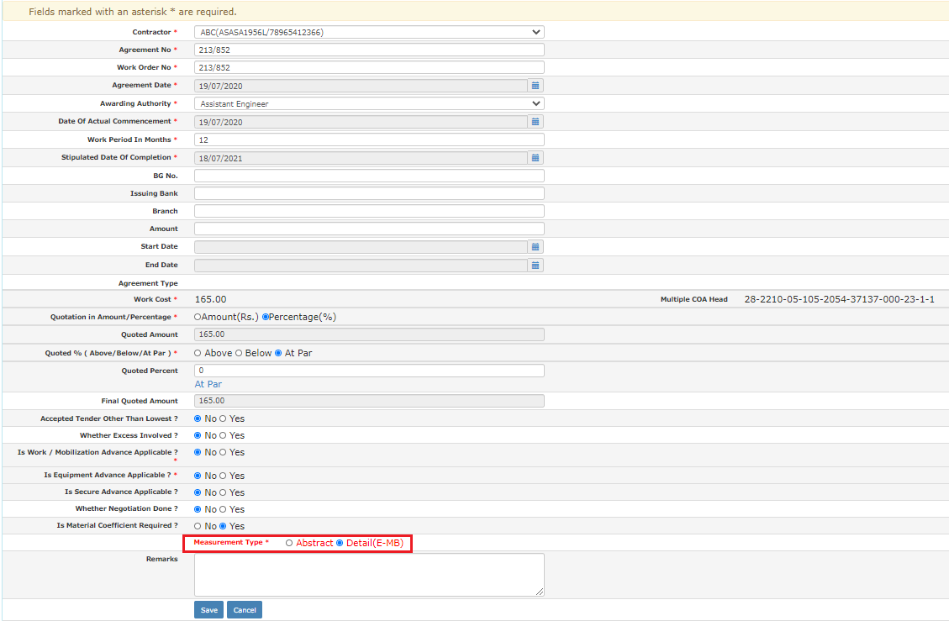
Agreement screen
The AOC details will show in the agreement screen against the work which would be non-editable and the same can be finalized from the concerned authorities.
User can also select to do the billing process through Abstract mode or e-MB mode.

Slide 51
Thank You

